Slide 1
Campus Budget & Planning Forum
Fall 2023
Sonoma State University
October 3rd, 2023

Slide 2
President’s Welcome

Slide 3
Fall Budget Briefing
Laura Lupei
AVP University Budget and Resource Planning

Slide 4
2023-2024 Final State Budget
$23M Inflation on Nonpersonnel Costs
$13.7M Insurance Premium Increases
$6M Maintenance of New Facilities
$311.5M Employee Compensation & Benefits
$129.3M Other Program Adjustments
$50M Academic Facilities and Infrastructure
$13.7M Insurance Premium Increases
$6M Maintenance of New Facilities
$50.6M Strategic Resident Enrollment Growth
$50.5M Employee Benefits
$75M Graduation Initiative 2025 & Basic Needs
$50.6M Strategic Resident Enrollment Growth
$3.1M Graduation Initiative 2025 & Basic Needs
$529.8M – Support Budget Request
$253.3M- Final State Budget

Slide 5
Campus Budgeted Revenue: 2023-2024
Notes:
University Budget – University Budget Plans – 2022-2023 – University Balances by Division 063022

Slide 6
2023-2024 Campus Budget Revenue Composition
Campus
Budget
$137.7 M
State
Allocation
66.08%
Tuition & Fees
22.15%
Cost
Recovery
11.77%
Total 23/24 Campus Revenue Budget: $137,696,642
Notes:
Today, I will be talking about our Campus Budget which is composed primarily of three funding sources: our state allocation, student tuition and cost recovery, which are funds recovered from our self-support and auxiliary partners for the support provided by the University.
I want to note that this presentation will not include information about self-support or auxiliary funds, as it is intended to be somewhat brief but we will be including more information about those funds in future presentations as we move towards a more all funds view of the University budget.

Slide 7
2023-2024 Campus Expense Budget by Type
Total 23/24 Campus Expenditure Budget: $146,958,095

Slide 8
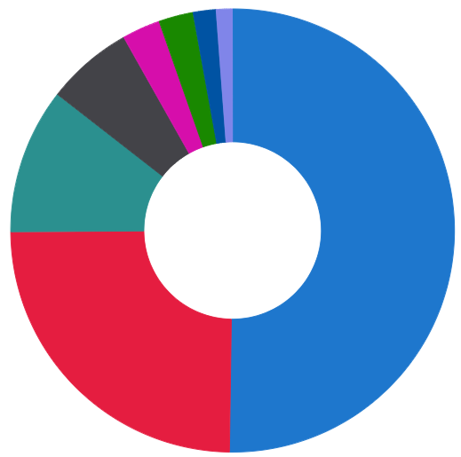
2023-2024 Budget by Division
President’s Office
2.52%
University Advancement
1.67%
Strategic Enrollment Management
2.78%
Green Music Center
1.18%
Student Affairs
6.32%
University Wide
10.61%
Academic Affairs
50.22%
Administration
and Finance
24.69%
Total 2023-2024 Campus Expenditure Budget:
$ 146,958,095
Benefits are distributed to Divisions
State University Grants are not included
Notes:
Add percentages put on one slide

Slide 9
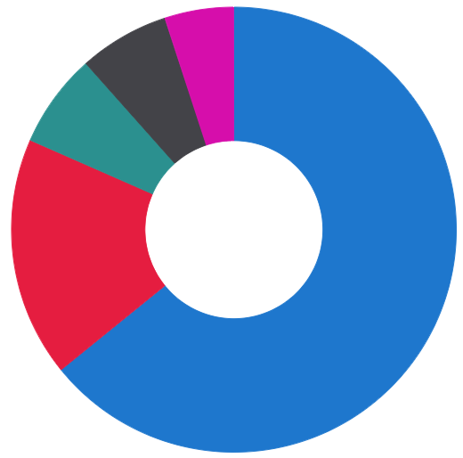
2023-2024 University Budgeted Revenue
Additional State/ Federal Funding
$10.8M
Source | Total
Campus Budget | $ 137,696,642 | 64.16%
Additional State/Federal Funding
Lottery | $ 1,057,000
Office of Research and Sponsored Programs | $ 9,710,000
 | $ 10,767,000 | 5.02%
Campus-Based Fees
Associated Students | $ 2,457,332
Campus Union | $ 5,778,840
Center for Performing Arts | $ 546,599
Counseling and Psychological Services | $ 800,846
Instructionally Related Activities | $ 434,497
Intercollegiate Athletics | $ 2,138,643
Library | $ 215,067
Student Health Center | $ 2,282,000
 | $ 14,653,824 | 6.83%
Other Fee Based Fund Sources
Residential Education and Campus Housing | $ 30,922,513
School of Extended and International Education | $ 4,622,000
Transportation and Parking Services | $ 1,871,879
 | $ 37,416,392 | 17.44%
Other Funding
Green Music Center | $ 3,412,900
Sonoma State Enterprises | $ 8,221,327
Sonoma State University Foundation Endowment Earnings Distribution | $ 544,334 $ 1,888,581
 | $ 14,067,142 | 6.56%
Total University Resources | $ 214,601,000 | 100.00%
Campus Based Fees
$14.7M
Other Funding
$14.1M
Other Fee Based Fund Sources
$37.4M
Campus Budget
$137.7M
Notes:
Add percentages put on one slide

Slide 10
2023-2024 Campus Base Deficit

Slide 11
2023-2024 Campus Deficit Detail – Base Changes

Slide 12
2023-2024 Campus Deficit Detail – Total Deficit

Slide 13
2023-2024 Campus Deficit Plan – One-Time Funds

Slide 14
2024-2025 Budget Planning Timeline
September
Board of Trustees Budget Request
January
Governor Releases Budget Plan
May
Governor Releases May Revision
June
Governor Approves Budget
July
Chancellor's Office Releases Final Budget Memo

Slide 15
2024-2025 Preliminary Budget Planning
Base deficit of $9.3M from 23/24 to roll to 24/25
Collective bargaining outcomes may impact campus budget
Board of Trustees approved a multi-year tuition increase effective in the 24/25 year
State allocation/Governor’s compact funding
CSU Enrollment Reallocation Memo
Campus strategic enrollment growth efforts

Slide 16
2023-2024 Campus Budget Plan available on
OpenBook
Accessed through the Budget Office website: budget.sonoma.edu Questions? Please email budget@sonoma.edu
Notes:
Add percentages put on one slide

Slide 17
Campus Updates
President Mike Lee
Sonoma State University

Slide 18
Townhall Question and Answer Session
Notes:
Add percentages put on one slide

