Slide 1
Campus Town Hall
Sonoma State University
Thursday, October 24th, 2024

Slide 2
Campus Updates & 2025-2026 Budget Planning
Interim President Emily Cutrer
Sonoma State University

Slide 3
In early scenario planning for 2025-2026, the projected deficit is an estimated $21M.
2025
-
2026
2024
-
2025 Base Deficit
$ (7,414,813)
Campus Share of System
-
wide $397M State Budget Reduction
$ (8,025,000)
5% Enrollment Reallocation (Estimate)
$ (3,640,000)
Adjustments to Revenue and Expense
$ (1,650,000)
Total, 2025
-
2026 Projected Deficit
$ (20,729,813)

Slide 4
Town Hall
Comment and Question & Answer Session

Slide 5
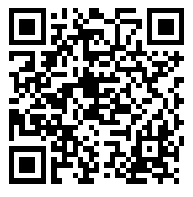
Please continue to submit comments and questions via Qualtrics form located at budget.sonoma.edu
Qualtrics Feedback Form

